Slide 1
Handling NJ Income Tax and Property Tax Recoveries
TP4F Preparer Page

Slide 2
Recoveries
A recovery is a return of an amount you deducted or took a credit for in an earlier year
Most common recoveries are refunds, reimbursements, and rebates of deductions itemized on Schedule A in earlier year:
State income tax refund
Property tax reimbursement (PTR)
Homestead Benefit (HB)
Others – such as medical expense reimbursement
Tax benefit rule
Must include a recovery in your income in the year you receive it up to the amount by which the deduction/credit you took for the recovered amount reduced your tax in earlier year
Notes:
2

Slide 3
Is State Income Tax Refund a Recovery?
Determine if there was a tax benefit in prior year from NJ income tax paid
No tax benefit in earlier year if:
Taxpayer did not itemize (claimed standard deduction) OR
Elected to deduct State & Local sales tax instead of State & Local Income tax
If there was no tax benefit in earlier year, don’t declare refund in current year
If there was a tax benefit in earlier year, some or all of NJ income tax refund may have to be declared as income in current year

Slide 4
Verify Amount of State Income Tax Refund
Amount of previous year NJ income tax refund must be verified
Amount could have changed from what is shown on prior year return (error found, return amended, etc.)
Can get info on NJ income tax refund from NJ Division of Taxation website Refund Lookup Tool
Link from TP4F Preparer page to NJ Form 1099-G Inquiry (Refund)
Need SS # and Date of Birth
Notes:
4

Slide 5
Example of NJ Income Tax Refund Recovery
On Intake/Interview sheet, taxpayer marked that he received a NJ income tax refund in 2019 when he filed his 2018 NJ return
Looking at prior year return, counselor saw that taxpayer itemized deductions on Schedule A and claimed state income taxes paid on Line 5a
Check box on Line 5a is not checked if state income taxes were claimed
Counselor verified refund amount using NJ Form 1099-G Inquiry (Refund) link on TP4F Preparer page
DID TAXPAYER RECEIVE A TAX BENEFIT LAST YEAR BY CLAIMING STATE INCOME TAXES PAID?
IS NJ INCOME TAX REFUND A RECOVERY?
DOES NJ INCOME TAX REFUND NEED TO BE CLAIMED AS INCOME IN 2019?

Slide 6
Is NJ Income Tax Refund a Recovery?
DID TAXPAYER RECEIVE A TAX BENEFIT LAST YEAR BY CLAIMING STATE INCOME TAXES PAID? YES, HE CLAIMED INCOME TAXES PAID ON SCHEDULE A LINE 5a
IS NJ REFUND A RECOVERY? YES
DOES IT NEED TO BE CLAIMED AS INCOME IN 2019? YES, SOME OR ALL OF REFUND MAY BE TAXABLE ON CURRENT YEAR RETURN

Slide 7
Declaring NJ Income Tax Recovery on Current Year Return
Use NJ Tax Refund Worksheet on TP4F Preparer page to determine how much of income tax recovery is taxable
Only taxable to the extent that:
Prior year total itemized deductions exceeded standard deduction
Prior year NJ income taxes paid exceeded NJ sales tax paid
Declare taxable amount of income tax recovery on Schedule 1 Line 1 of current year return

Slide 8
PTR and HB Recoveries
PTR checks and HB credits on property tax bill are considered recoveries if the taxpayer received a prior year tax benefit by claiming real estate taxes on Schedule A Line 5b
PTR – Based on last year’s return
HB – Based on return from 3 years ago
Must ask taxpayer if they itemized and claimed real estate taxes, since tax return from 3 years ago is probably not available
If taxpayer is unsure, assume they did itemize

Slide 9
PTR and HB Recoveries
cont’d
If recoveries, PTR and HB payments may be taxable on current year Federal return
Use NJ Tax Refund Worksheet on TP4F Preparer page to determine how much of PTR and HB payments are taxable
HB will always be fully taxable; NJ Tax Refund Worksheet only works with last year’s Schedule A numbers, not 3 years ago
Taxable amounts of property tax recoveries will be declared on Schedule 1 Line 8 as Other Income

Slide 10
Example of PTR and HB Recoveries
During interview, taxpayer stated that he received a PTR check in 2019 for property taxes he paid in 2018
Taxpayer also stated that he received a HB credit on his 5/1/2019 property tax bill and another credit on his 11/1/2019 bill for property taxes he paid in 2016
Counselor verified amounts of PTR and HB by using online inquiry tools on TP4F Preparer page or other documentation
Counselor looked at prior year return and saw that taxpayer itemized deductions on Schedule A and claimed property taxes on Line 5b
Counselor verified with taxpayer that he itemized 3 years ago and claimed property taxes
DID TAXPAYER RECEIVE A TAX BENEFIT LAST YEAR AND 3 YEARS AGO BY CLAIMING PROPERTY TAXES?
ARE PTR AND HB RECOVERIES?
DO PTR AND HB NEED TO BE CLAIMED AS INCOME IN 2019?

Slide 11
Are PTR and HB Recoveries?
DID TAXPAYER RECEIVE A TAX BENEFIT LAST YEAR BY CLAIMING PROPERTY TAXES? YES, HE CLAIMED PROPERTY TAXES ON SCHEDULE A LINE 5b IN 2018
DID TAXPAYER RECEIVE A TAX BENEFIT 3 YEARS AGO BY CLAIMING PROPERTY TAXES? YES, HE CLAIMED PROPERTY TAXES ON SCHEDULE A LINE 5b IN 2016
ARE PTR AND HB RECOVERIES? YES
DO THEY NEED TO BE CLAIMED AS INCOME IN 2019? YES, SOME OR ALL OF THESE PROPERTY TAX REFUNDS MAY BE TAXABLE ON CURRENT YEAR RETURN

Slide 12
Process to Determine and Enter Amount of Recoveries to Claim as Income on Current Year Return
Complete NJ Tax Refund Worksheet on TP4F Preparer page
Worksheet is pretty self-explanatory; just enter amounts requested
Schedule A amounts are obtained from prior year return
One exception - State sales tax for prior year is a required field; however, if taxpayer claimed state income taxes on prior year Schedule A Line 5a, sales taxes would not be shown on Schedule A
Either income taxes or sales tax is shown on Line 5a, whichever is claimed
To determine prior year sales tax, complete Sales Tax Worksheet on TP4F Preparer page

Slide 13
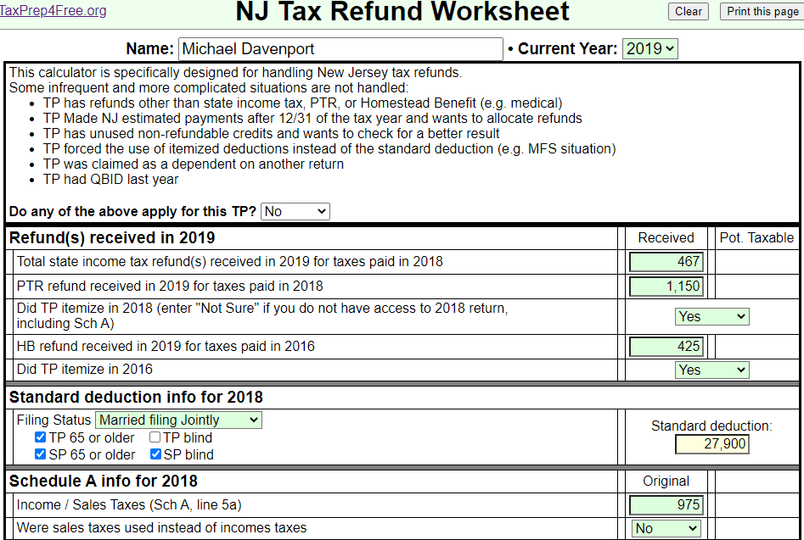
NJ Tax Refund Worksheet for Recoveries – Top Half
NJ income tax
refund
PTR
HB
Use info from
prior year return

Slide 14
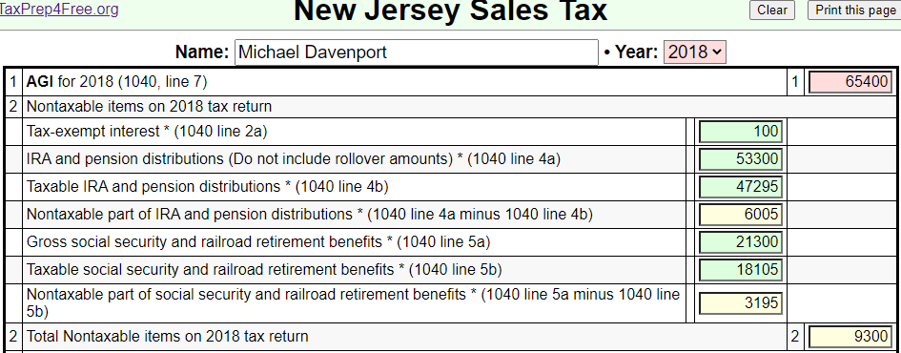
Use NJ Sales Tax Worksheet to Determine Prior Year Sales Tax Amount
Be sure to set year
to prior year
Use info from
prior year return
Other nontaxable
items not on tax
return could also
be included for
total income; look
at actual Worksheet
2018 Sales Tax
to be used on
NJ Tax Refund
Worksheet

Slide 15
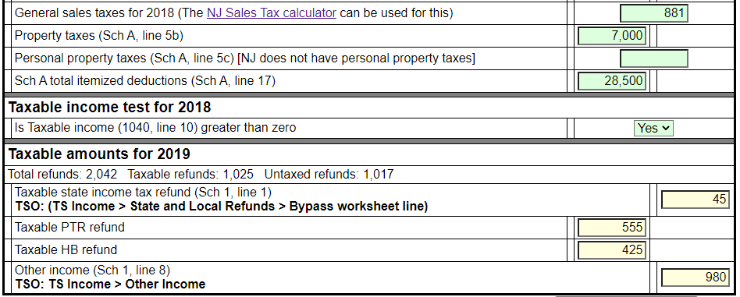
NJ Tax Refund Worksheet for Recoveries – Bottom Half
From NJ Sales Tax
Worksheet
Use info from
prior year return
Taxable amount of
income tax refund
Taxable amount of PTR
Taxable amount of HB

Slide 16
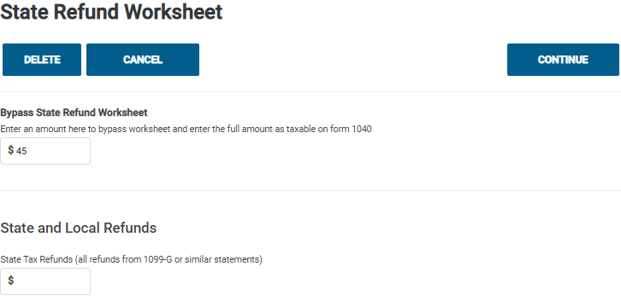
TSO – Entering Taxable Amount of State Income Tax Refund Federal Section>Income>Form 1099-G Box 2
Bypass TSO State Refund Worksheet since we
used tool on TP4F
Taxable amount of
income tax refund from
NJ Tax Refund Worksheet

Slide 17
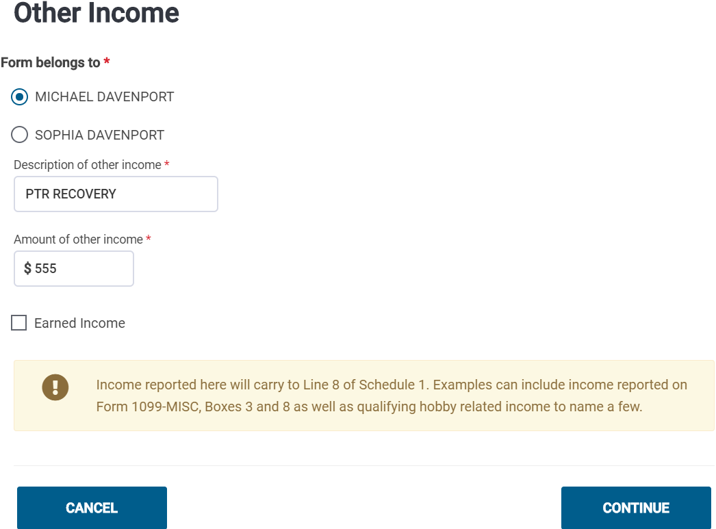
TSO – Entering Taxable Amount of PTR Federal Section>Income>Less Common Income>Other Income Not Reported Elsewhere
Taxable amount of PTR
from NJ Tax Refund Worksheet

Slide 18
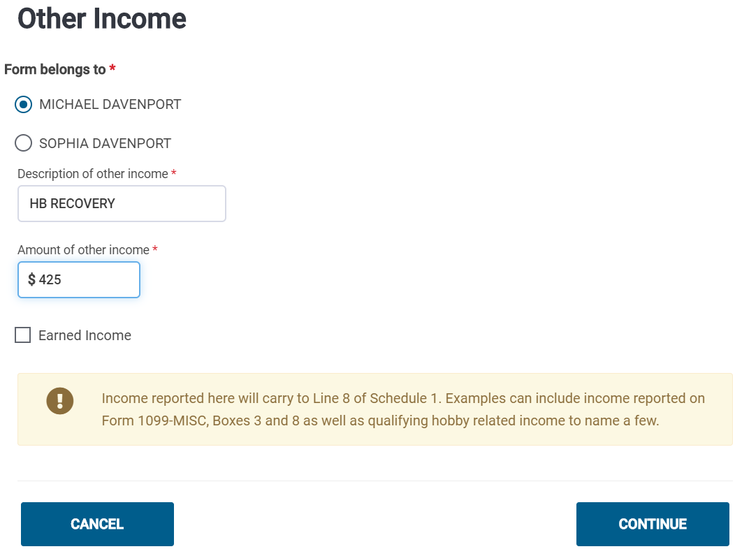
TSO – Entering Taxable Amount of HB Federal Section>Income>Less Common Income>Other Income Not Reported Elsewhere
Taxable amount of HB
from NJ Tax Refund Worksheet

Slide 19
Recoveries on NJ Checklist
State income tax recovery does not flow through to NJ 1040
No need for NJ Checklist entry
PTR and HB recoveries on Federal Other Income line do flow through to NJ 1040 Other Income line (Line 26)
Need to enter PTR and HB recoveries as negative amounts as Adjustments to Line 26 in Income Subject to Tax section of NJ Checklist

Slide 20
PTR and HB Recoveries on NJ Checklist

Slide 21
Behind-the-Scenes Calculations on NJ Tax Refund Worksheet
If you wish to understand the details of the calculations used to determine the taxable amounts of the recoveries on the NJ Tax Refund Worksheet, click on “Show intermediate calculations” at bottom

